Slide 1
Simulating Blob Physics
By: Rory Bennett, Shinell Manwaring, and Andy Luo

Slide 2
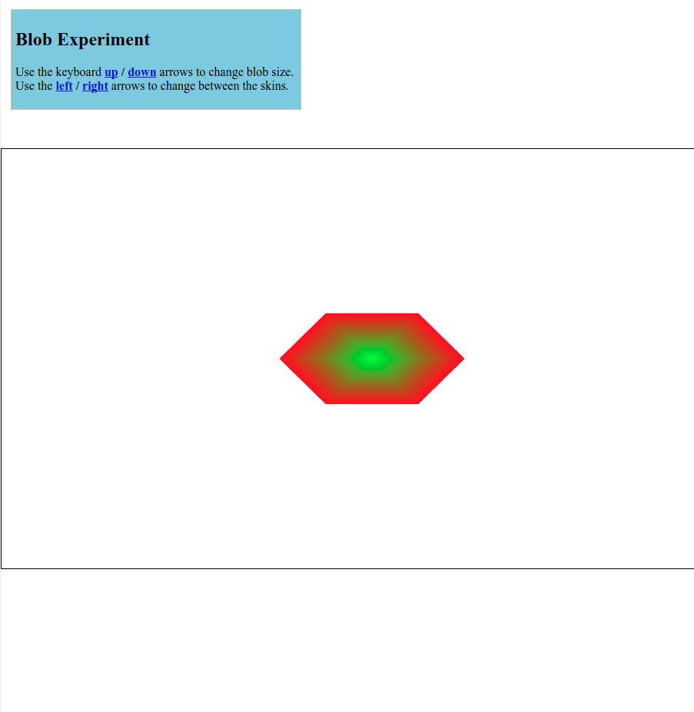
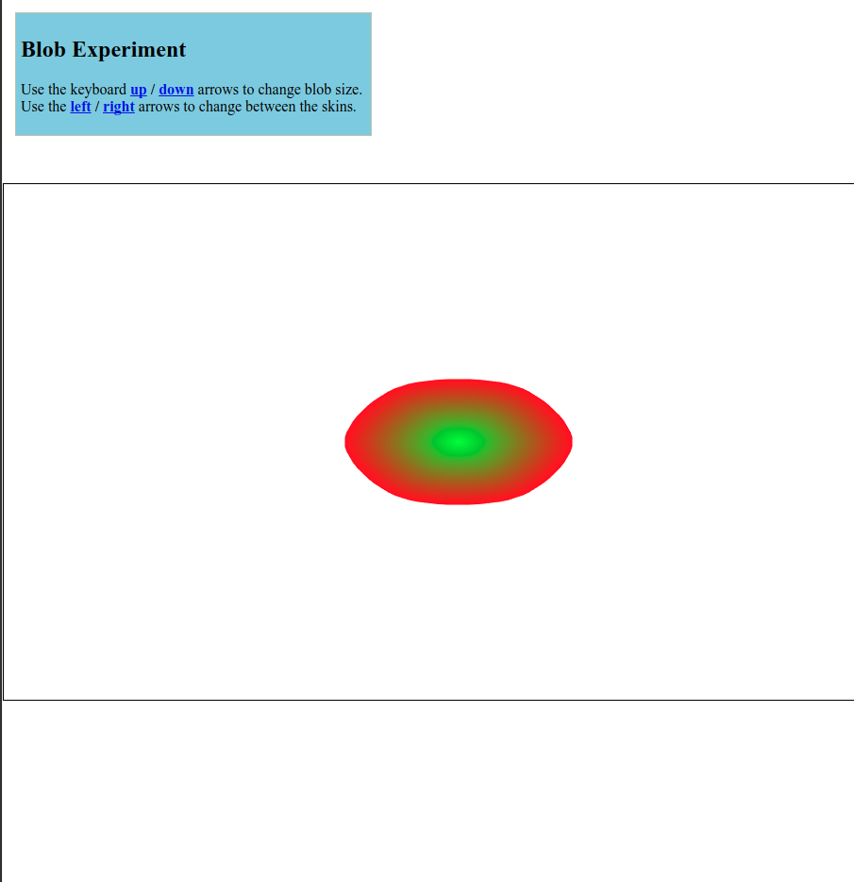
Rendering with Bezier Curves

Slide 3
Finding Control Points
P1
P2
P0
P3
P0
P3

Slide 4
Calculating Individual Points
u^T = [1 t t^2 t^3]
p = [p_0 p_1 p_2 p_3]
M_B =
p(t) = u^T(M_B)(p)
P1
P2
P0
P3
1 0 0 0
-3 3 0 0
3 -6 3 0
-1 3 -3 1

Slide 5
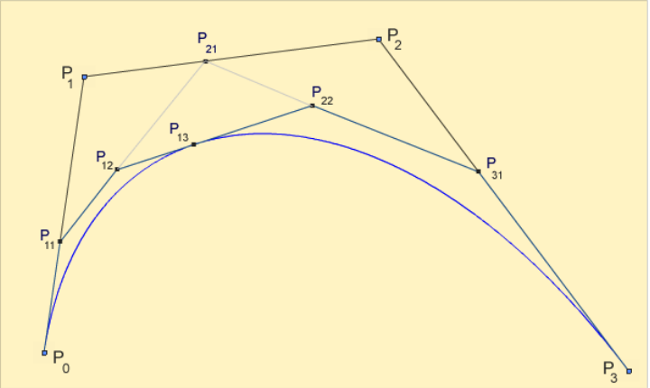
DeCasteljau’s Recursive Algorithm
Idea: Given the tangent lines formed by the control points, take the derivative of a point along each tangent line, connect those points to form a (n - 1)-degree curve
If we continue taking derivatives and connecting points, we get a single point, i.e., a point on the original curve

Slide 6
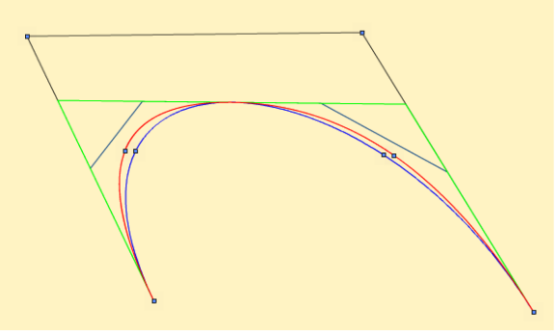
Recursive Base Case: Flattening
Given: a cubic Bezier curve B and a quadratic approximation to that curve, Q.
Take distance between the two curves’ midpoints:
C(0.5) - Q(0.5) = (p_0 + 4(p) - 3(p_1+ p_2) + p_3)/8
If distance is small enough, just connect the four control points of the cubic curve

Slide 7

Applying Gravity
, G = 6.674×10⁻¹¹ m³⋅kg⁻¹⋅s⁻²
In real world, g = 9.8 (on earth)
In our project, we use g = 0.01
v = v₀ + gt
pos = pos₀ + vt
repeat

Slide 8
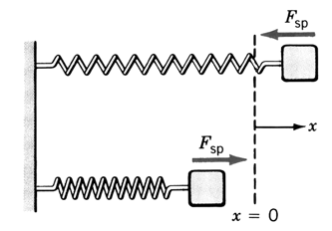
Spring Force
Hooke’s Law
F = - k * (length - ideal length)

Slide 9
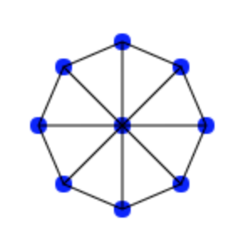
Apply Forces on Blob
Force on a node
Gravitational force
Spring forces of all connected springs

Slide 10
Apply damping
First calculate acceleration using Newton’s Second Law
a = Spring Force / mass
Then update velocity and position with damping coefficient
v_{new} = d *(v₀ + at)
pos_{new} = pos₀ + vt

Slide 11
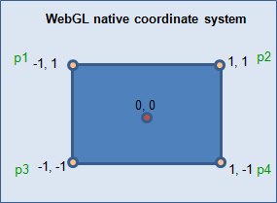
Converting from Pixels to WebGL Coordinates
The canvas height = 546px; The canvas width = 964px;
The top left corner is (0px, 0px); top right corner = (964px, 0px); etc.
A transformation of (x,y) allows you to convert pixels into WebGL Coordinates

Slide 12
Checking for collisions
Check that all Vertices do not exceed canvas boundary
Boundary Cases:
Y < -1; BottomHit
Y > 1; TopHit
X > 1; RightHit
X < -1; LeftHit
Apply a force to send the blobs velocity in the opposite direction

Slide 13
Canvas: Mouse Event Listeners
Mouse Event Listeners track the interaction with the canvas
Event detected on canvas → Call appropriate function
Listeners Implemented:
canvas.onclick = getMousePosition;
canvas.onmousedown = mouseDown;
canvas.onmouseup = mouseUp;
canvas.onmousemove = mouseMove;

Slide 14
Canvas.onclick

Slide 15
Canvas.onmousedown/up/move

Slide 16
Future Work
Integrating springs into our current model
Adding addition user customization options:
The ability to change between skins using the left/right arrows
the ability to change the blob size using the up/down arrows

Slide 17
Resources Used
Hakim El Hattab’s Blob Example (https://lab.hakim.se/blob/03/)
Matter.js (http://brm.io/matter-js/)
Soft Body Demo (http://brm.io/matter-js/demo/#softBody)
Soft Body Demo GitHub (https://github.com/liabru/matter-js/blob/master/examples/softBody.js)
Research Paper: http://kucg.korea.ac.kr/education/2005/CSCE352/paper/provot95.pdf

